Slide 1

Note Reader
Emmett Fitzharris | R00222357 | SDH4 | INTR8015
Notes:
Thank you for joining me today, I appreciate your time and attention.
My Name is Emmett, and today I’ll be presenting my Final year project, NoteReader
An application suite built to improve the workflow of organising study material and notes.

Slide 2
Presentation Structure
Introduction
A brief overview of the concept
Research Phase
A short recap of the research phase of the project
Implementation
Review the actual implementation, and the changes from the original plan
Difficulties and Challenges
What went wrong, and what was learned
The Future of NoteReader
What’s next for the project
Notes:
Today we will run through: - an introduction to the project,
a very quick recap of the research and design phase,
The process of implementing the project and a look at the prototype.
Difficulties and challenges encountered during the development phase
And the future of the project going forward.
There is a lot to cover, so we’ll just right in.

Slide 3
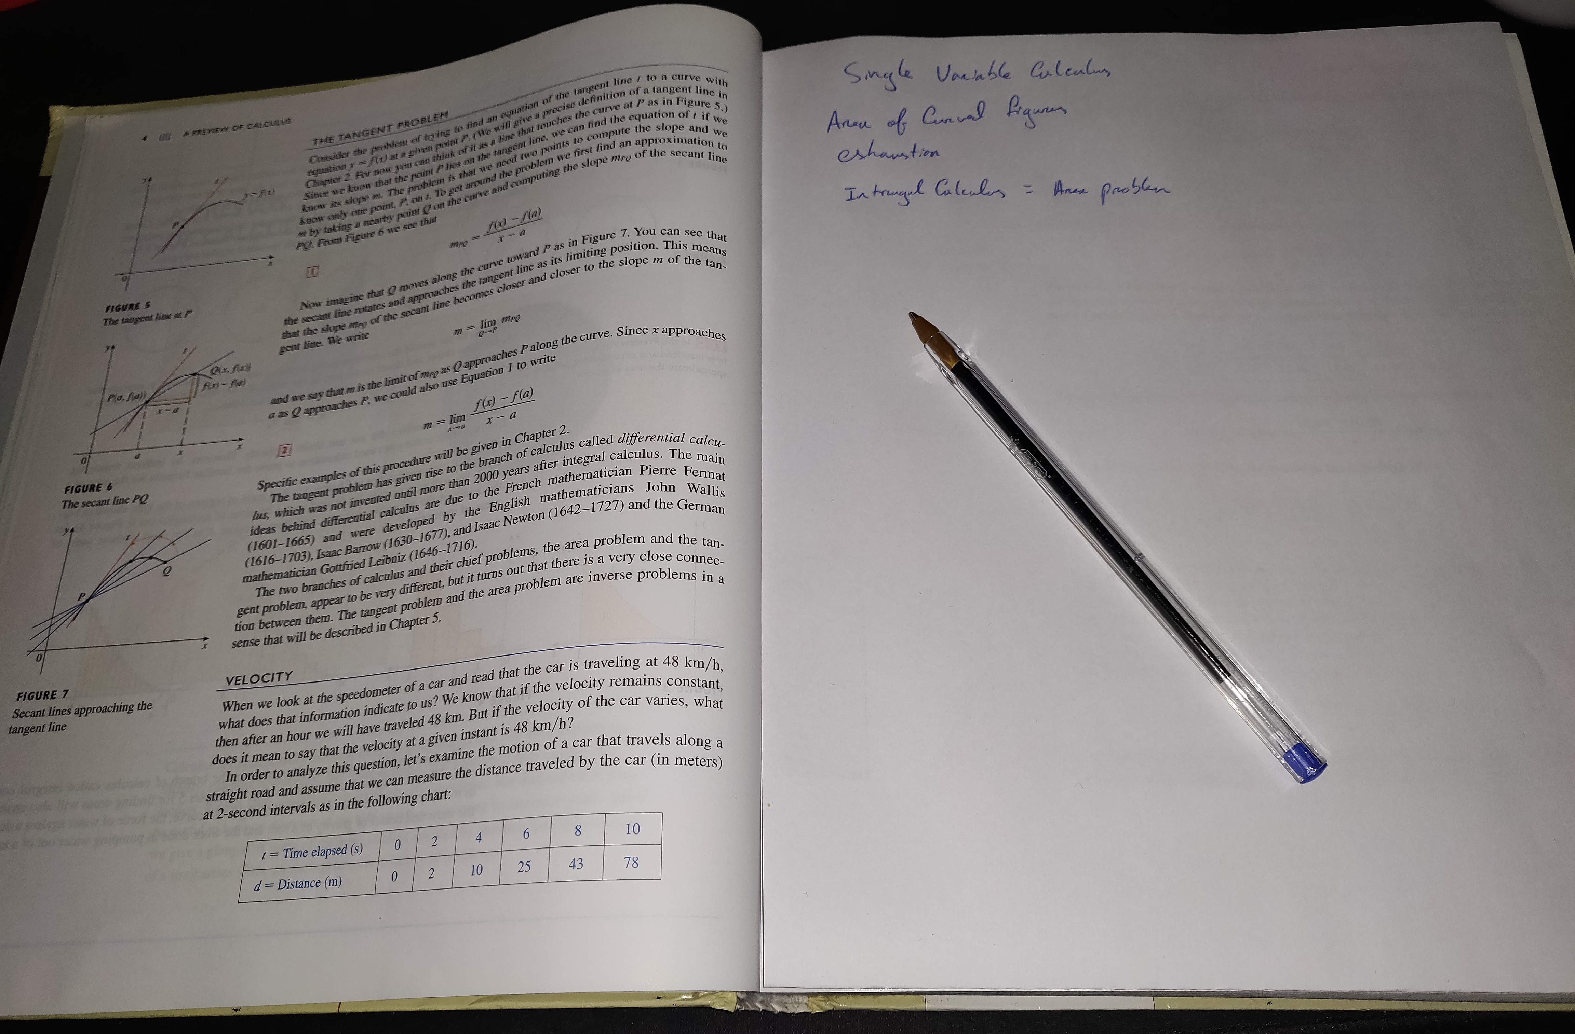
Introduction
Picture a book with a blank sheet of paper slotted between each page.
As you read, you take notes. Flip to the next page, a new sheet awaits you.
When it’s time to revise, you go back to that page and your notes on the topic are right there.
This is the feeling Note Reader wants to achieve.
Notes:
The core concept of note reader is the ability to Read documents and take notes in a single interface.
Accessing these notes and source materials should be as simple as possible, so you can get the most out of your time studying.
The visual metaphor I like to use is a book, with sheets of blank paper slotter between each page.
Every time you open a page of the book, your notes on that page are right there waiting for you.

Slide 4
Project Summary
An all-in-one interface for document reading and note-taking.
Each page of notes is directly tied to a page of the source document.
The core interface of NoteReader is the Split-View.
Left Pane: “true-to-intent" rendering” of a wide range of common file types, including PDFs, Word Documents, PowerPoint slides, and eBooks. | Right pane: Text editor with Markdown and HTML rendering, to allow for richly formatted notes.
Notes:
The motivation of this project is to address flaws in currently available note taking solutions that I have observed in my time in college.
It is born from a personal frustration after trying many options over years and never finding a solution that fit all my needs.
- I want a reader which renders documents faithfully to the authors intent.
- I want a 0 friction way to create and store notes.
- I don’t want to download a new program every time I come across a new file format.
- I don’t want to have to check multiple places (cloud, my laptop, my pc at home, my phone, various app storage) to find my notes.
- I don’t want to pay a subscription fee forever, to keep my college notes stored in a cloud service.
Everything should be in one spot.

Slide 5
Background Research
E. M. Stacy and J. Cain, “Review note-taking and handouts in the digital age. 2015
Advocates for a “skeletal” handout structure to provide cognitive scaffolding, while encouraging engaging with material without full transcription.
The above would be well supported by a split-pane application like Note Reader.
D. Sun and Y. Li, “Effectiveness of digital note-taking on students’ performance in declarative, procedural and conditional knowledge learning,” International Journal of Emerging Technologies in Learning, vol. 14, pp. 108–119, 2019
Shows evidence of small performance benefits to digital note taking, especially in declarative knowledge.
Structure of Note Reader application may further support conditional knowledge, by ensuring context remains intact.
B. Artz, M. Johnson, D. Robson, and S. Taengnoi, “Taking notes in the digital age:
Evidence from classroom random control trials,” Journal of Economic Education, vol. 51, pp. 103–115, 4 2020.
No statistically significant difference found between digital and handwritten notes on retention.
Topics dependant on diagrams/mathematical elements may give advantage to traditional note taking.
Notes:
Some research performed before beginning design.
Supports:
- Cognitive benefits of note taking.
- Effectiveness of digital notes
Skeletal Handouts, limited content, annotated by students to provide full context.
Encode not transcribe.

Slide 6
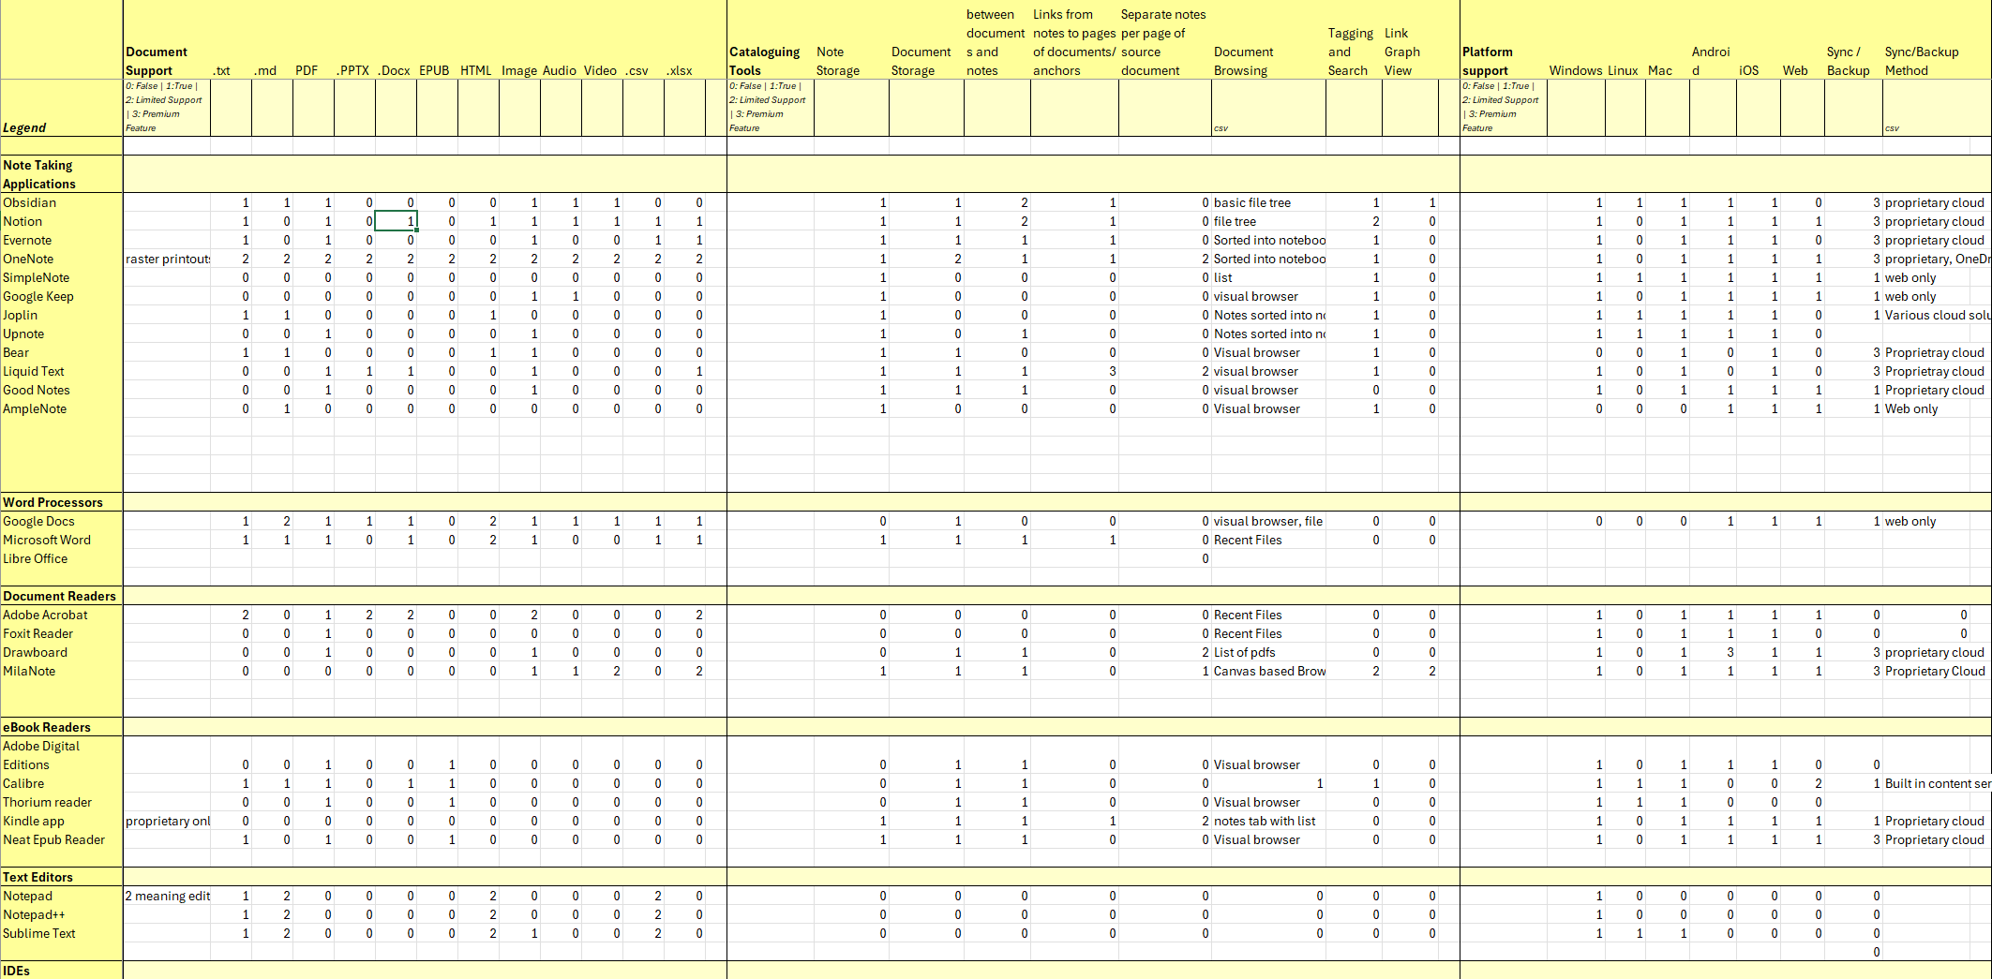
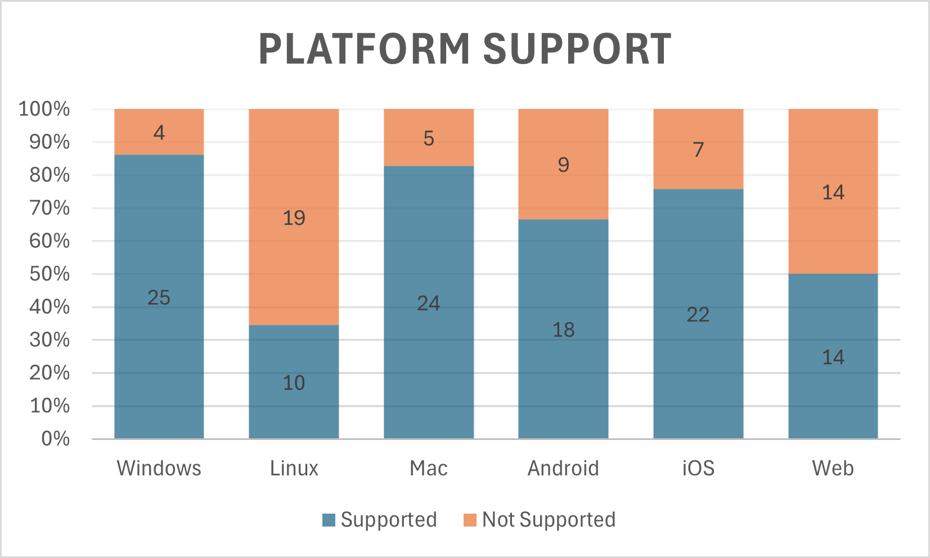
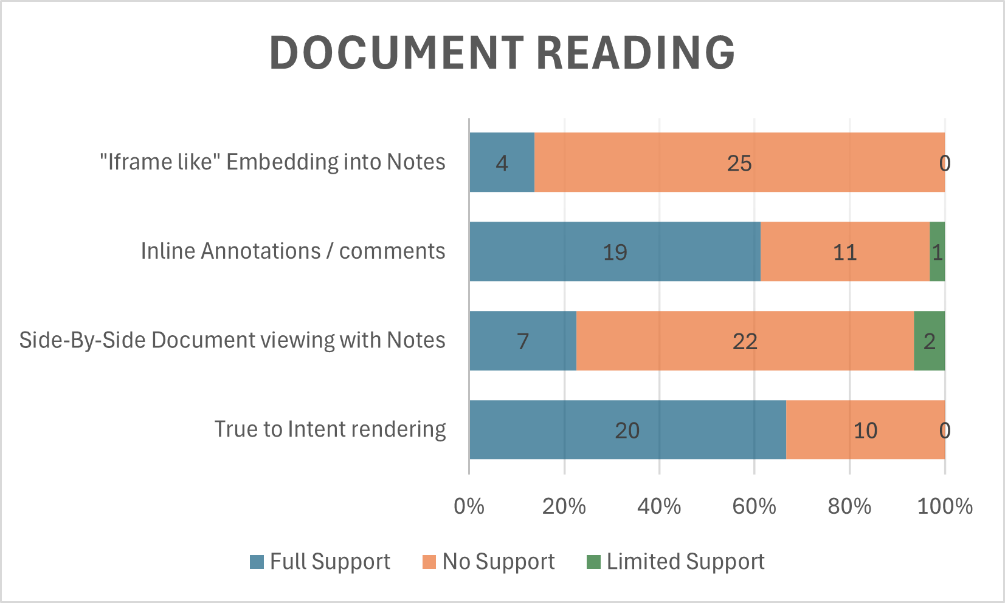



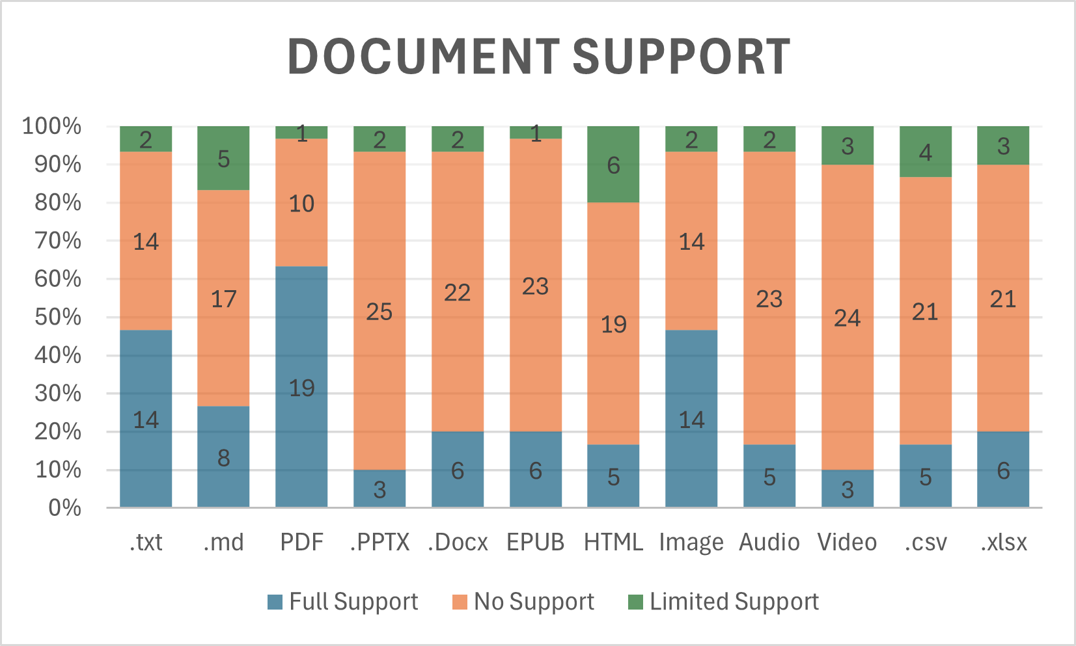



Existing Solutions
32 programs were reviewed, to determine current levels of support offered by existing solutions.
The programs were categorized and checked against a list of features.
Notes:
Most support a small number of file types.
Those which do often modify the original destructively, eg printing to a canvas.
Ebooks are especially poorly supported.
Platforms like linux are also very poorly supported.

Slide 7
Current Issues
Fragmentation of Tools
Document readers have weak support for note taking, and vice versa.
Limited Multi-Platform Support
Linux support is rare. Cross functionality is a challenge.
High Cost of Subscription Services
Especially for cloud storage and accessing data on multiple devices.
Inadequate File Type Support
Power Point support is especially rare
Manual Organization and Storage
Loss of Context, misplaced documents, wasted time.
Notes:
- Non portable annotations,
bespoke file types,
large file sizes, small at first, adds up over time, continual cost from that point on.
- No application supports a page of notes per page of document. - Those which are close, do so using a canvas with destructively printed documents.

Slide 8
Problem Definition
Despite the availability of numerous note-taking applications and document readers, there exists a significant gap in the seamless integration of these two functionalities.
The primary objective is to develop a cohesive system that allows
users to read and annotate documents, create linked notes, and access these materials in an organized and intuitive manner, without destructively modifying the source material.
Notes:
So this is the problem definition.
In a space as crowded as text editing and document reading, there is no solution which seamlessly integrates the two.
NoteReader aims to be an all-in-one, platform-agnostic application that treats both document reading and note-taking as first-class priorities

Slide 9
Unique Value Propositions
Side-by-Side document reading and note taking
Support a wide Range of commonly used document types
Multi-Platform Design approach
Git-based file Synchronization
Notes:
- Reduce friction in taking notes,
- Reduce fragmentation of tools
- Use open-source lightweight methods to synchronize files.

Slide 10
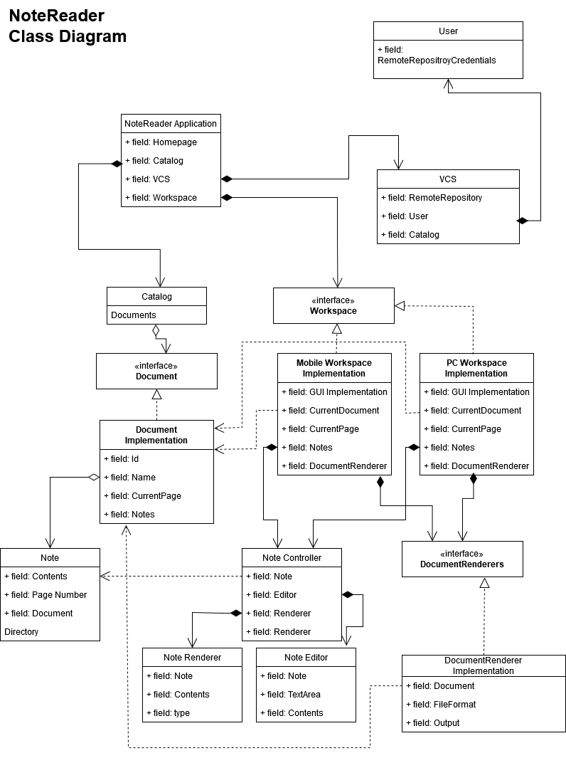
Implementation Approach
User centric design approach
Agile based project management
Core application built in Kotlin Multiplatform
Abstract GUI interfaces to ensure consistency across platforms.
Notes:
High level overview
Central application, with a core pipeline.
File format or platform specific implementation slotted in without needing to rewrite the full codebase.

Slide 11
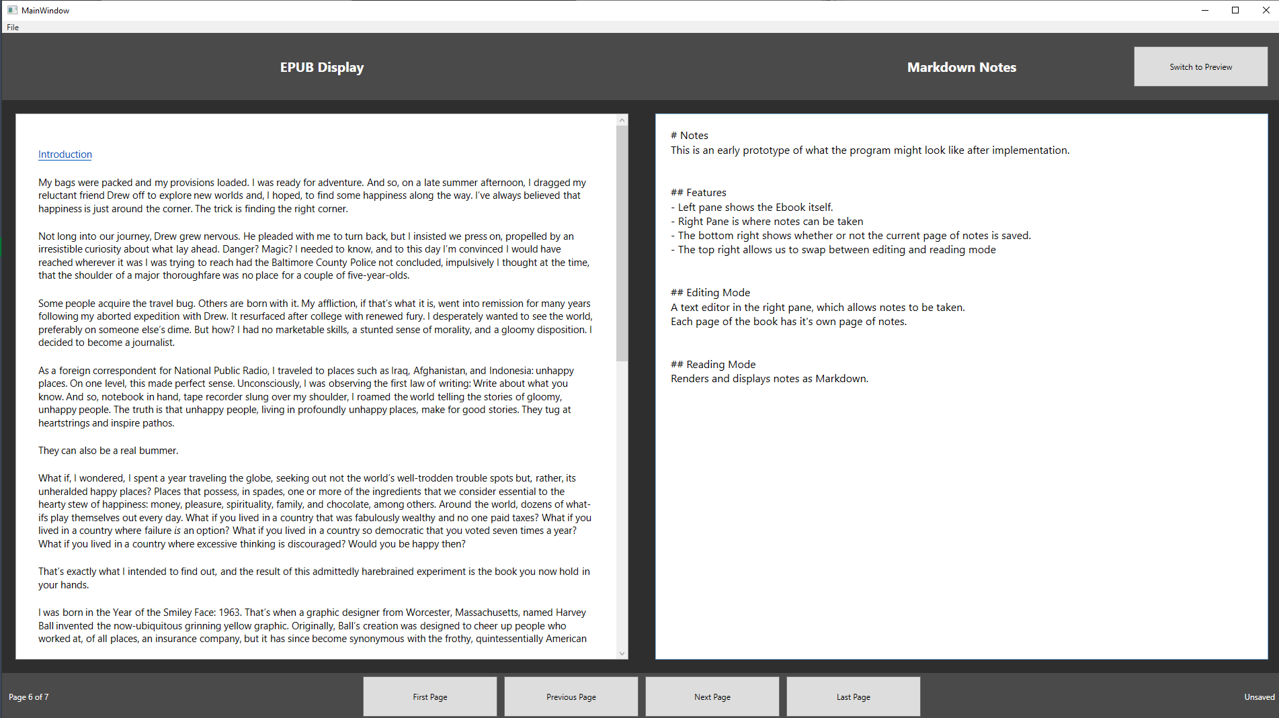
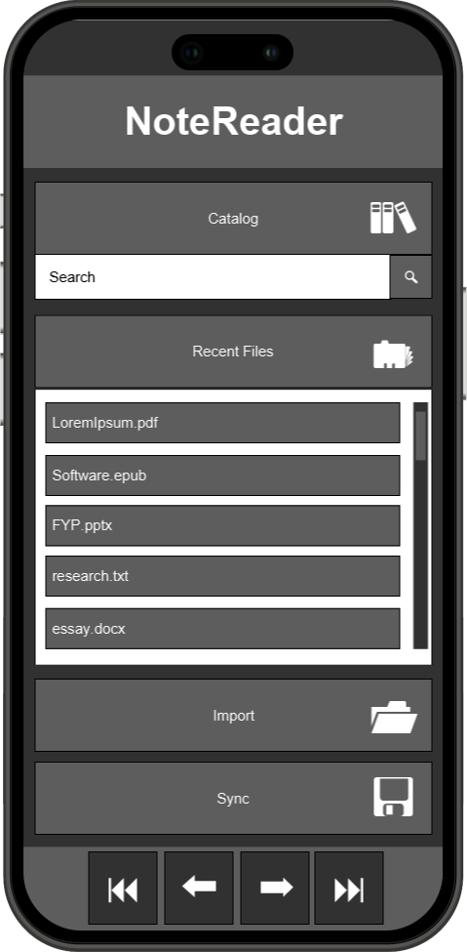
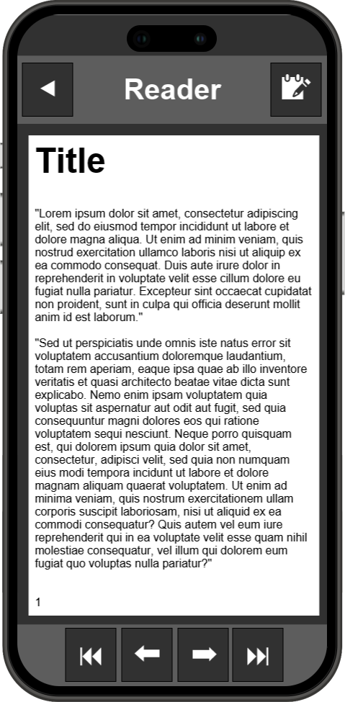
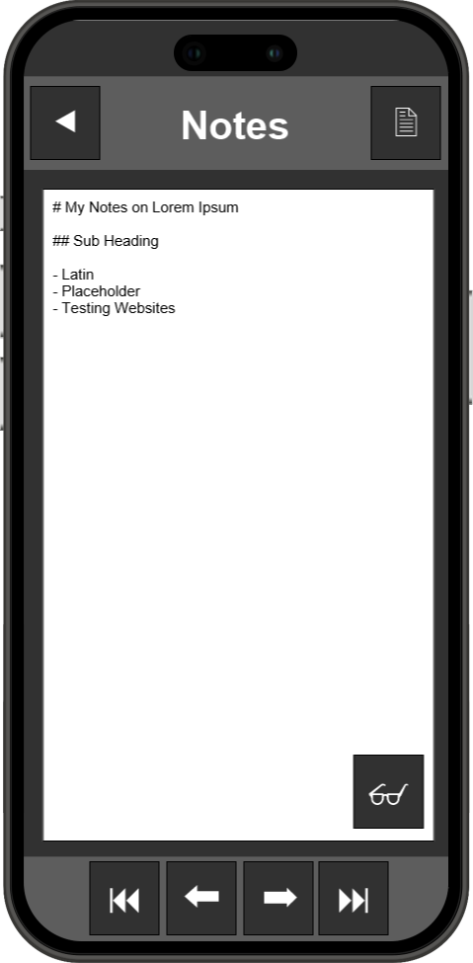
Early Prototypes
Desktop Application
Mobile Application
Notes:
Designed in Semester 1
A preview of what the desktop application may look like, two pane display
Desktop in WPF c#, mobile in JustinMind

Slide 12
Implementation Plan Schedule
Sprint 1
Sprint 2
Sprint 3
Sprint 4
Sprint 5
Sprint 6
PDF and Text Editor with Linked Pages
Document and Note Cataloguing and Search
Improved Document Format Support
Version Control and Sync
UI/UX Enhancements
Prototyping and Integration of Additional Features
Notes:
Six sprints of approximately two weeks each.
Early production of executables will allow for frequent user testing and iteration.
A little ambitious, as challenges were encountered this was revised.

Slide 13
Actual Implementation Schedule
Sprint 1
Sprint 2
Sprint 3
Sprint 4
Sprint 5
Document Rendering (PDF) and Linked Note Editor
Focus on File System and Program State
Expanded file format support (EPUB, DOCX, DOC, PPTX, HTML)
UI/UX Refinement and Theming
Prototype Integration and Documentation
Notes:
In the actual implementation, some elements were deferred, file sync and searching.
Preference given to MVP core features, strong file format support and delivering a completed product for the Desktop application.

Slide 14
Functional
Requirements
The system shall support searching and filtering of notes and documents using tags, keywords, and categories
Status: Deferred
The system shall provide a split-view interface to allow users to view documents and take notes simultaneously
The system shall support exporting notes in plain text format for use in other applications
Status: Fulfilled
Status: Fulfilled
The system shall support the import and display of PDF, EPUB, DOCX, and PPTX files
The system shall enable users to sync notes to cloud storage providers like GitHub using version control
Status: Fulfilled
Status: Deferred
The system shall allow users to link notes to specific pages or sections of the source document
The system shall allow users to tag and categorize notes for efficient organization and retrieval
Status: Fulfilled
Status: Deferred
Notes:
- searching and filtering of notes and documents using tags, keywords, and categories
sync notes to cloud storage providers
tag and categorize notes for efficient organization and retrieval
Deferred to later development cycles.

Slide 15
Non-Functional
Requirements
Portability: The system shall support cross-platform functionality on Windows, macOS, Linux, and mobile devices
Status: Deferred
Performance: The system shall load and display documents without noticeable wait times on standard modern devices
Reliability: The system shall gracefully handle unexpected crashes to prevent data loss by saving notes in real-time
Status: Partially Fulfilled
Status: Fulfilled
Usability: The user interface shall be intuitive, with clear user experience flows
Maintainability: The system shall be modular to allow for easy updates and addition of new features
Status: Fulfilled
Status: Fulfilled
Scalability: The system shall support large document files and offer alternative synchronization methods for these files.
Status: Partially Fulfilled
Notes:
Performance:
- Some document types, have short but noticeable load times.
Scalability
dependant on git synchronisation
Portability:
- Focus on core application, but built with expansion in mind.

Slide 16
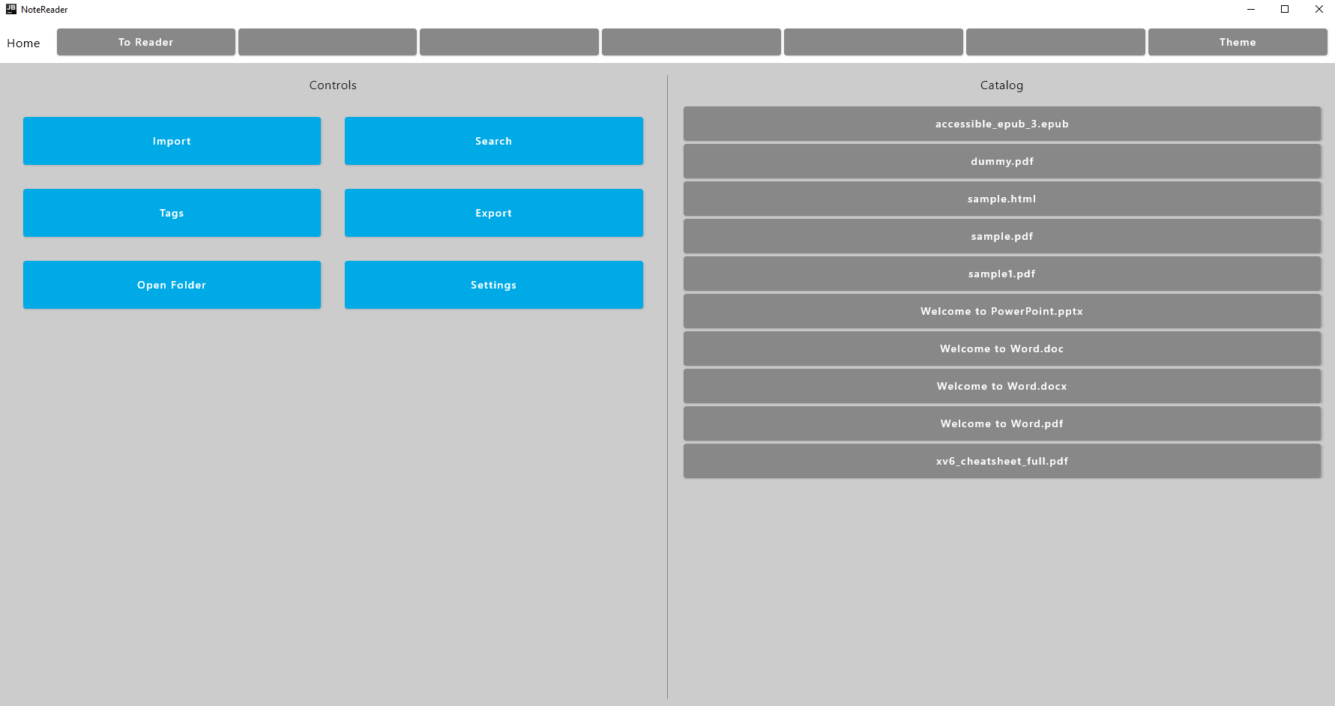
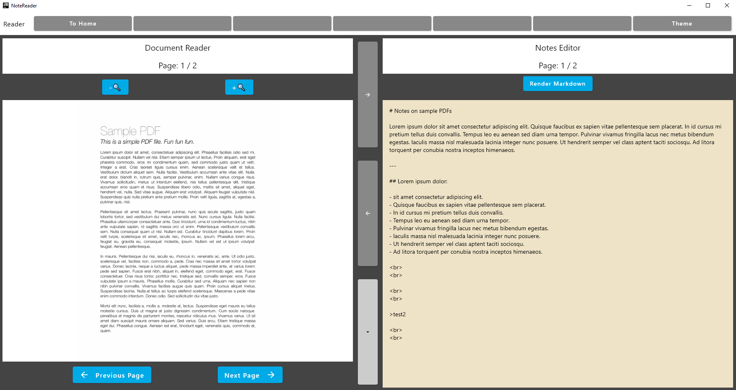
Implemented Prototype
Home Page
Reader View
Notes:
A couple of screenshots of the Prototype.
We will skip through these quickly, as I have a video to demonstrate the functionality

Slide 17
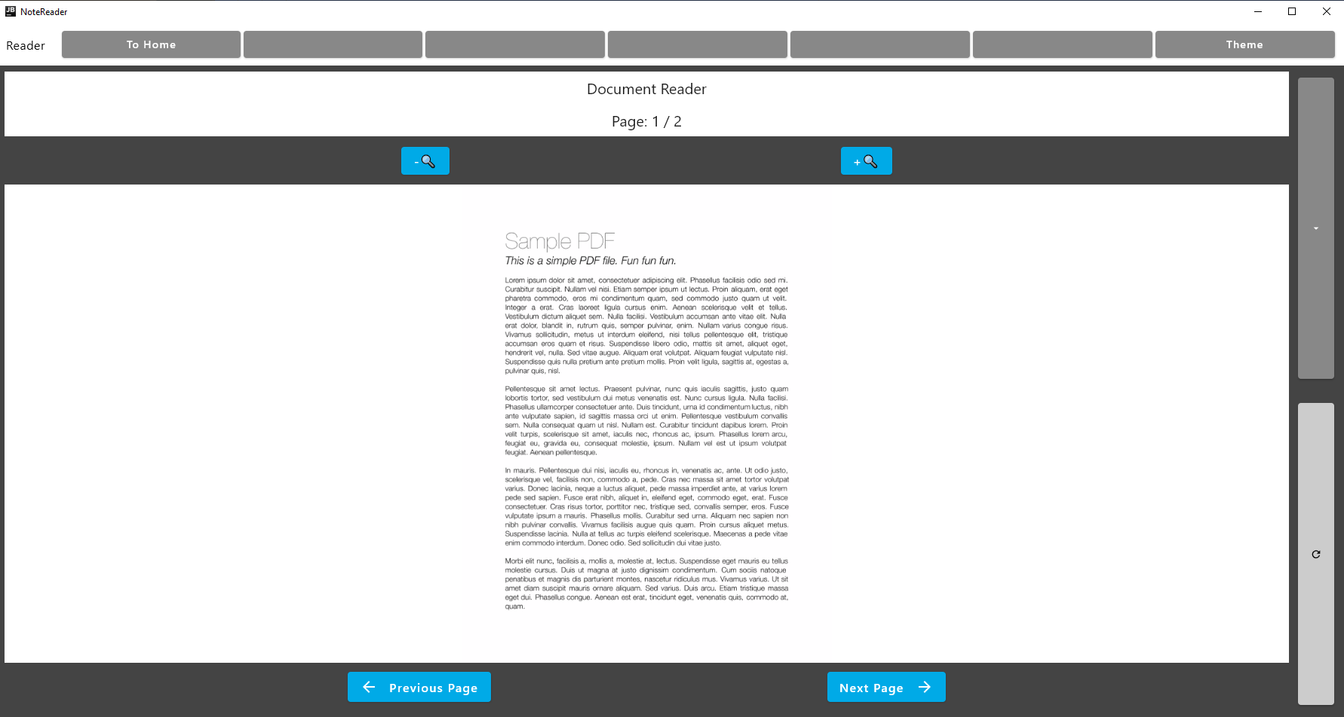
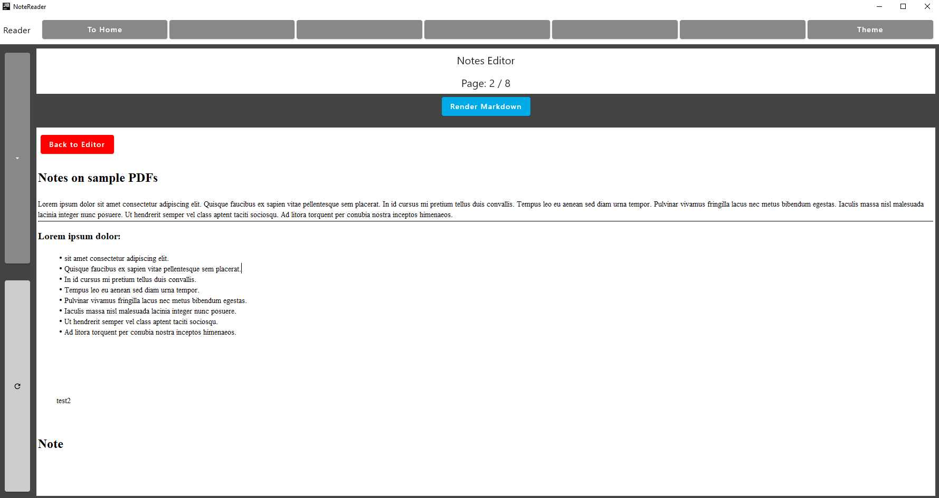
Implemented Prototype
Reader Focus Mode
Notes Markdown Focus Mode
Notes:
Show video now
---
So that should give you an idea of where the project is at.
Next we’ll talk about challenges

Slide 18

Challenges Encountered
Framework Immaturity:
Kotlin Multiplatform first stable release November 2023
Limited documentation and community support
Third-party plugins and libraries often experimental or poorly supported
Java cross-compatible, giving access to Java Libraries, but not trivial to implement
Document Rendering:
Native per-format support involved significant development cost
Fallback to PDF conversion approach adopted
Time Constraints:
Scope reigned in, deferring some requirements to ensure delivery of MVP with core features
Notes:
Some of the primary challenges encountered:
Kotlin Multiplatform is still very new.
Documentation and other Support is not as mature as other platforms
Fallback to PDF Approach allows us to more quickly support many file types using existing tooling like LibreOffice and Calibre command line tooling.
PDF conversion is only performed in backend,
does not affect original file which is preserved for archival
Limited development time,
focus on core product.

Slide 19
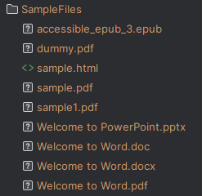
Testing
A range of sample files selected to represent typical academic study material
Manual testing validated:
Document Import and Rendering
Note Creation and Retrieval
Session Persistence
File System Inspection
Notes:
Testing was extensive but manual,
A lack of automated testing may lead to blind spots over time.
Manual testing appropriate for the graphical elements of the application
Subsequent development cycles should focus on unit testing as a priority.

Slide 20
Discussion and Evaluation
The completed NoteReader prototype delivers a focused and practical solution to the challenge of fragmented note-taking and document reading workflows.
Supports all targeted document formats, with split view interface for notes.
Document-page-to-note linking, real time saving and session persistence
Sprint plan was adapted to challenges encountered in implementation
Some requirements were deferred to later development cycles after re-evaluation
Notes:
So in summary, there were elements of the project which did not go to plan, but the core premise of the application remained intact.
Sprint plan was adapted as challenges were encountered, with some requirements deferred.
A focused prototype was produced, which achieves a proof-of-concept solution to the problem definition:
- Despite the availability of numerous note-taking applications and document readers, there exists a significant gap in the seamless integration of these two functionalities.
Wide document support with side-by-side note taking and reading was fulfilled addressing the issue of fragmentation of tools.

Slide 21
Conclusion
There is a clear gap in the features offered by currently available applications.
Existing tools are fragmented and none treat both note taking & document reading as first class priorities.
NoteReader has potential to address these shortcomings, while supporting cognitive benefits.
Cutting-edge frameworks provide useful features, but may introduce new limitations ecosystem support.
The project achieved a core Minimum Viable Product, which addresses the problem definition.
The project acts as a solid proof of concept and illustrates the value of the premise.
There are several areas identified for further development and enhancement.
The architecture is built to accommodate easy addition of new features and platforms.
Notes:
NoteReader addresses a gap in currently available tools
Using a new Framework was beneficial but brought its own challenges.
Core premise was achieved, but there is a long way to go to a fully featured product.
The program is built to grow and accommodate updates gracefully.

Slide 22



The Future of NoteReader
Catalogue System
Git Integration
Cross-Platform Expansion
Optical Character Recognition
Handwriting Support
Improved UI
Direct Integration with Open-Source Learning Management Systems
Startup Accelerator
Notes:
1. Future work:
- Some deferred features, several stretch goal features not core to prototype
2. Direct access for students, package for universities
3. Place secured in startup accelerator:
- I fully believe in the value of the project
- Intend to continue developing the product to a polished and useful state

Slide 23
Thank You!
Questions and comments welcome
Notes:
Thank external examiner for time and attention.
Thank Deirdre and Kapal for support
Appreciate the opportunity

